Slide 1

Table of Contents
Introduction
Setup
Importing Swagger 2.0 as a proxy
Assemble for Proxy Invoke
Mapping to Swagger Services
Mapping to XML Services
Move proxy API from V5 to V10
Moving a mapped API from V5 to V10
Importing a OpenAPI 3.0 for proxy API
Importing a SOAP proxy API
Cloning a V10 API
Create a new V10 API version
Create a new OpenAPI 2.0 using APIC V10
Create a new OpenAPI 3.0 using APIC V10

Slide 2
Table of Contents
Create a complex definition using the V10 UI
Create an API Product
Publish an API Product to the Portal
Delete an API Product from the Portal
Download Realization for an API

Slide 3
Introduction
What’s in here
This document provides general instructions for creating and configuring APIs in APIConnect Version 10. It will cover:
Importing Swagger generated from RSA
Importing vendor API specifications
Creating new APIs using the API Connect user interface
Moving APIs from Version 5 to Version 10
Setting up Products

Slide 4
Setup
Best Practices and Name Request location
Naming guides and Best Practices
API and Service Naming Tool Content
Integration Best Practices Cheat Sheet
Request a New Service or API Name
The API/Service Name Requests list found on the EAA SharePoint site
A guide for submitting Name Requests is found here

Slide 5
Setup
Request access to Development Provider Organization and Portal
Request access to the APIC Connect Development Provider Organizations.
Download a copy of the form and fill out.
Submit the form as instructed.

Slide 6
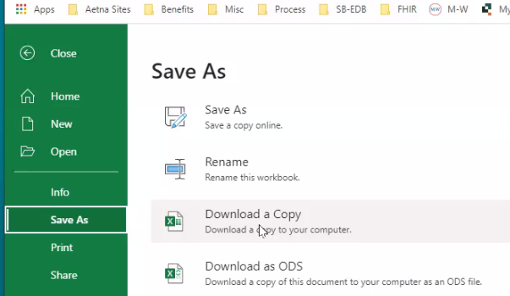
Setup
Request access to Development Provider Organization and Portal
Download a copy to the local space

Slide 7
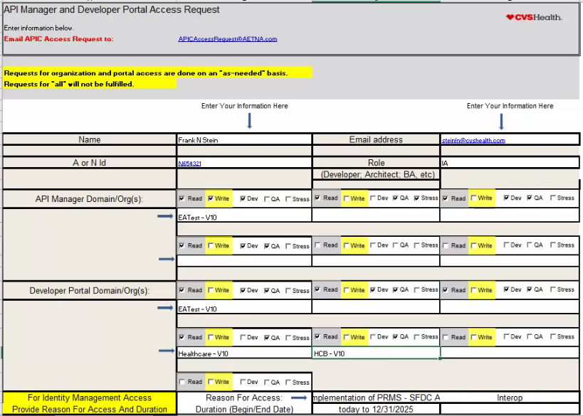
Setup
Request access to Development Provider Organization and Portal
Download a copy to the local space
Fill out and send to APICAccessRequest email address.
Make sure to select both the Developer and the Portal Domain .
Make sure to add “-V10” at the end of each domain selected.
Consider requesting the Healthcare and HCB QA portal for research purposes. This only needs to be done one time.

Slide 8
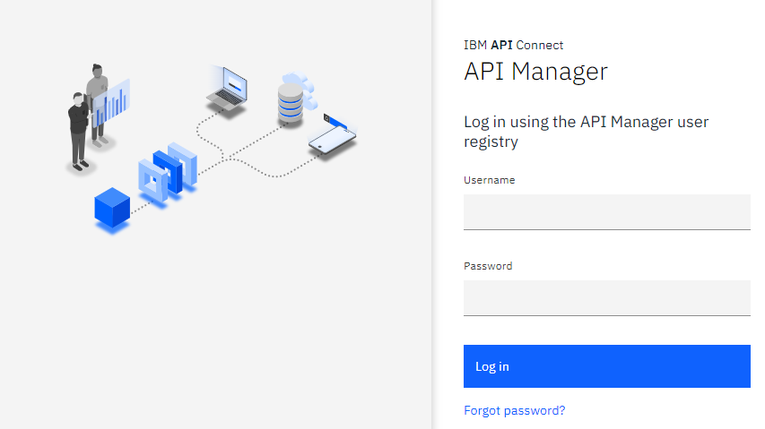
Setup
How to access the Development Provider Organization
Accessing the V10 APIConnect Manager
https://dev-apim.apps.dev.cloudpak-aznp.cvshealth.com/manager/eatest/
Enter your Username and Password
Click Login (be patient)

Slide 9
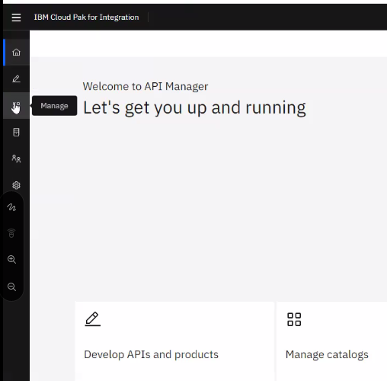
Setup
How to access the Development Provider Portal
After logging in
Click Manage

Slide 10
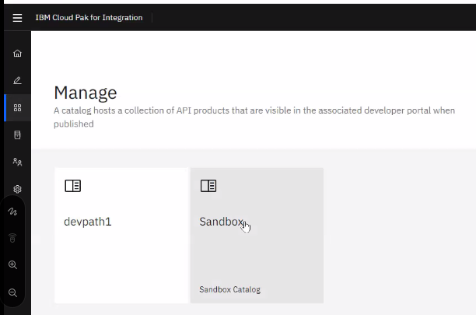
Setup
How to access the Development Provider Portal
Point to and click Sandbox

Slide 11
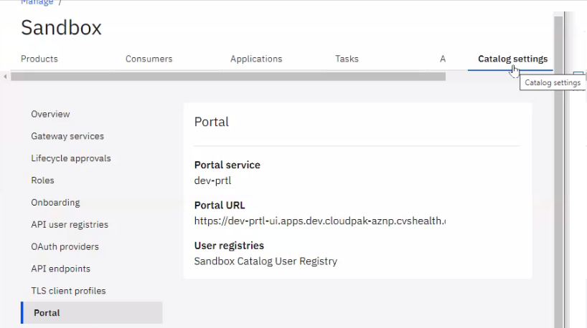
Setup
How to access the Development Provider Portal
Accessing the V10 APIConnect Portal
Click Catalog setting and Portal
Copy the Portal URL

Slide 12
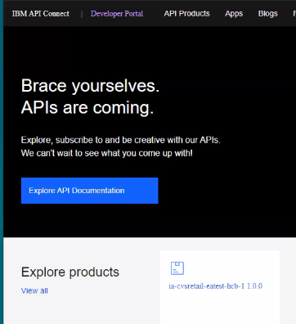
Setup
How to access the Development Provider Portal
Open a new Browser tab and Paste the Portal URL into the address
Sign into your account

Slide 13
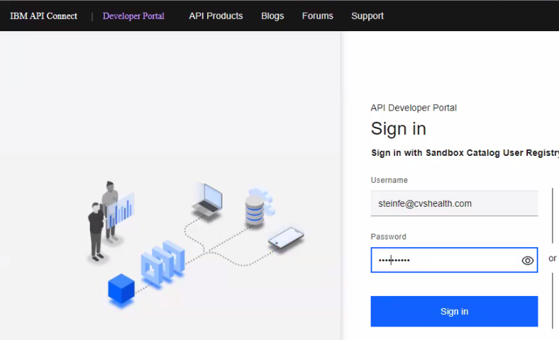
Setup
How to access the Development Provider Portal
Enter UserName and Password

Slide 14
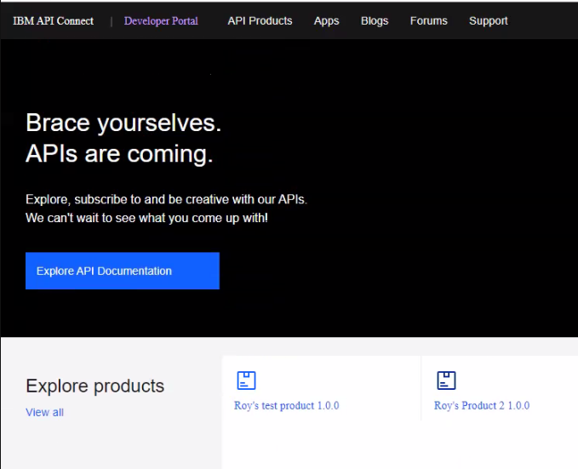
Setup
How to access the Development Provider Portal
Explore the APIS and Products. (Need a new screen shot)

Slide 15
Importing Swagger 2.0 as a proxy
Introduction
This section describes how to import a Swagger YAML or JSON file into API Connect v10. It assumes a validated YAML or JSON file and API Connect v10 is active and the correct Development Provider Organization is selected.
Return to the API Manager tab to perform this action.
Swagger 2.0 specifications can be found here.

Slide 16
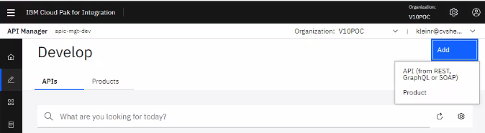
Importing Swagger 2.0 as a proxy
Add
Click Develop icon
Click the API tab
Click the Add button
Click API (from REST, GraphQL or SOAP)

Slide 17
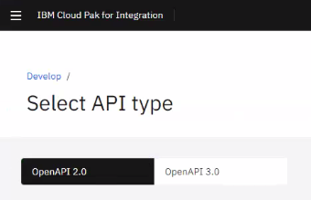
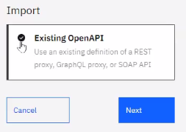
Importing Swagger 2.0 as a proxy
Select the API to import
Select OpenAPI 2.0
Under “Import”
Click on Existing Open API
Select Next

Slide 18
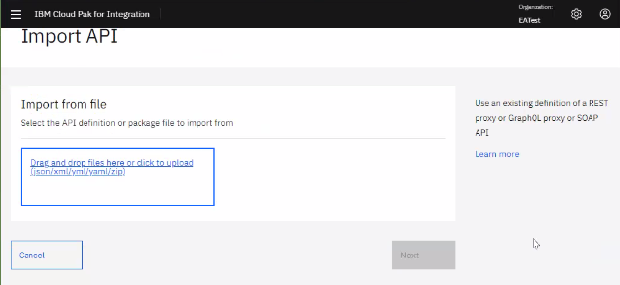

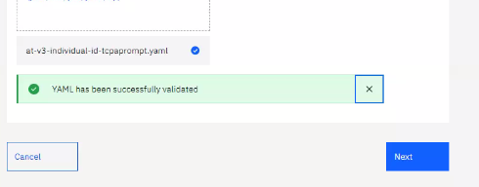
Importing Swagger 2.0 as a proxy
Select file to import
Drag and drop or click the screen to select the file to import
Select the file to import
File has been imported and successfully validated
Click Next

Slide 19
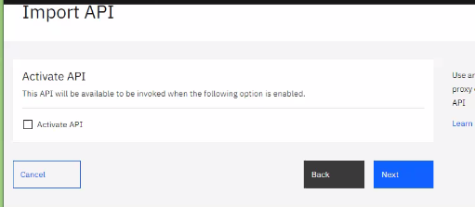
Importing Swagger 2.0 as a proxy
Post Import
Leave the Activate API check box unselected
Click Next

Slide 20
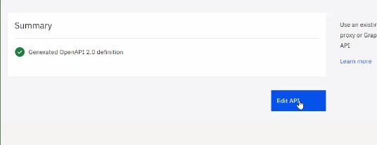
Importing Swagger 2.0 as a proxy
Post Import
Click Edit API

Slide 21
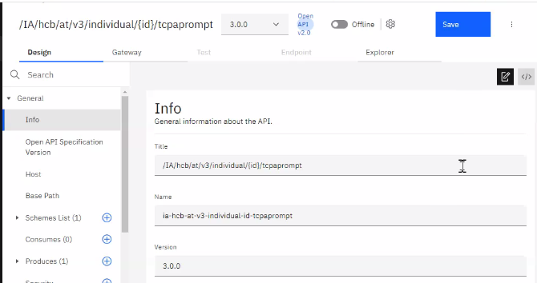
Importing Swagger 2.0 as a proxy
Finished Importing
The API has been imported
Look at the “Name” field on the Info tab
If there are any “_” (underscore) characters in the name field replace them with “-” (dash)
Go to the section “Assemble for Proxy Invoke”

Slide 22
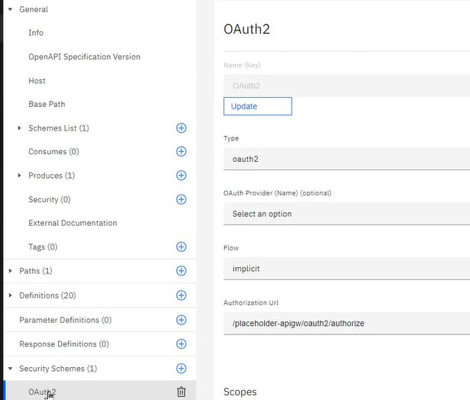
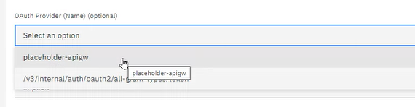
Importing Swagger 2.0 as a proxy
Finalizing Security
Expand Security Schemas
Select OAuth2 schema
Click Update
Select placeholder-apigw from the OAuth Provider dropdown
Select Implicit from the Flow dropdown
Click Save

Slide 23
Assemble for Proxy Invoke
Introduction
This section describes how to configure a proxy API using the Assemble tab in API Connect v10.

Slide 24
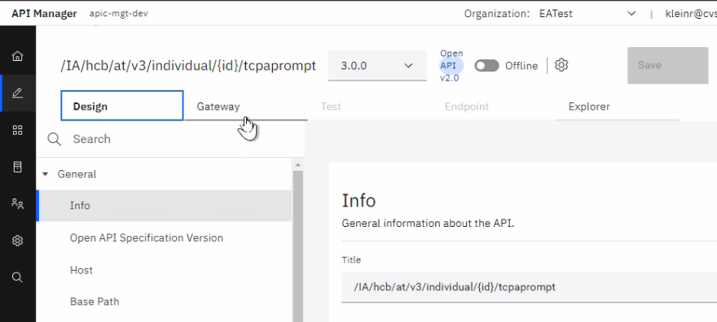
Assemble for Proxy Invoke
Invoke
This can be used for many of the APIs that we import and create
Click the Gateway tab

Slide 25



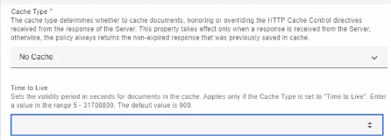

Assemble for Proxy Invoke
Invoke settings
Click on the invoke
Enter the service endpoint in the Description
Scroll down to set the following:
Set the http Method as Keep
Set Cache Type as No Cache
Ensure Time to Live is blank
Ensure Stop on error is not selected

Slide 26
Mapping to Swagger Services
Introduction
This section describes how to map a previously created Swagger API to a backend Swagger service. The Swagger service could be vendor generated or internally generated by an IA using RSA in the Swagger stream.
Some examples for creating these Opportunistic APIs are:
Reduce the payload for a mobile app.
To change the attribute names for a Vendor specific need.

Slide 27
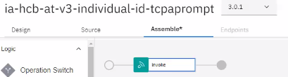
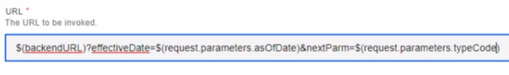
Mapping to Swagger Services
Configuring Backend Swagger service – Get Inputs
An API has already been created from YAML
On the Assemble tab Click the Invoke
Scroll down to view the URL in the bottom pane.
Update the URL, add a “?” after the $(backendURL) to begin the query parameters
Parameters are in the form of <key> = <value> and are separated by an &
Include all parameters needed for the Request
<key> is the expected service input parameter
<value> is in the form of $(request.parameter.<name>)

Slide 28
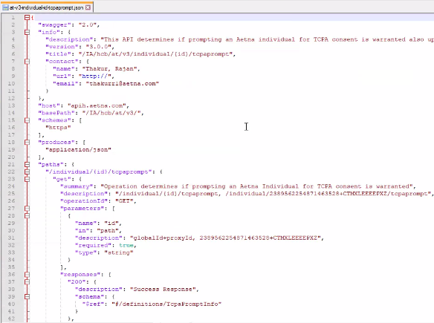
Mapping to Swagger Services
Configuring Backend Swagger service – Setup response payload
In order to generate the response structure for the output of the service use the following steps:
Obtain the JSON Swagger document for the back-end service
If a YAML file is provided convert to JSON using Swagger.IO or similar method
Open the JSON file with an editor like Notepad++

Slide 29
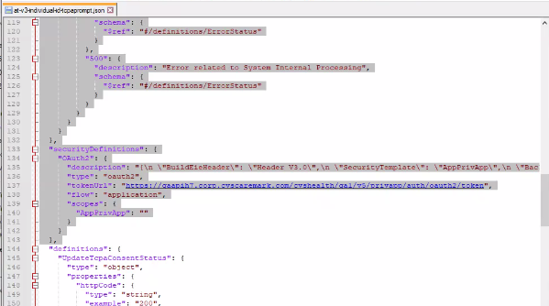

Mapping to Swagger Services
Configuring Backend Swagger service – Setup response payload
Remove all the lines above “definitions”: {

Slide 30
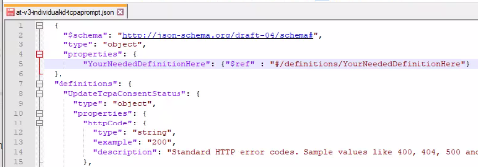
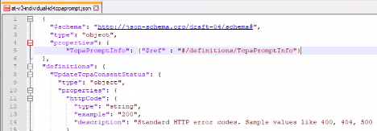
Mapping to Swagger Services
Configuring Backend Swagger service – Setup response payload
Insert the following above “definitions”: {
{
"$schema": "http://JSON-schema.org/draft-04/schema#",
"type": "object",
"properties": {
"YourNeededDefinitionHere": {"$ref" : "#/definitions/YourNeededDefinitionHere"}
},
Replace both instances of “YourNeededDefinitionHere” with the definition to be returned

Slide 31
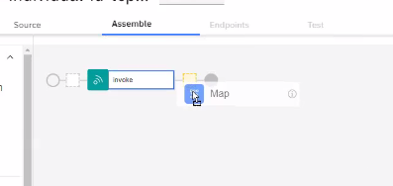
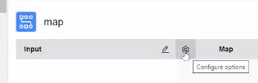
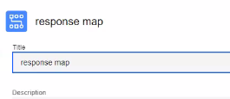
Mapping to Swagger Services
Configuring Backend Swagger service – Setup response payload
Save.
Highlight (CTL-A) and copy (CTL-C) the schema just created
Place an Output map on the Assemble
Rename the Map using the Configure options button

Slide 32
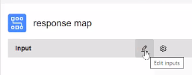
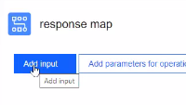
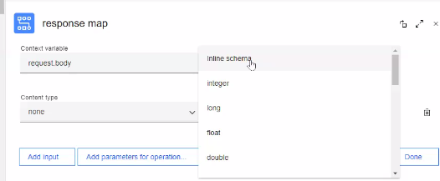
Mapping to Swagger Services
Configuring Backend Swagger service – Setup response payload
Open the Map
Click the Edit inputs pencil on the Input side
Click Add input
Select Inline schema from the Definition

Slide 33
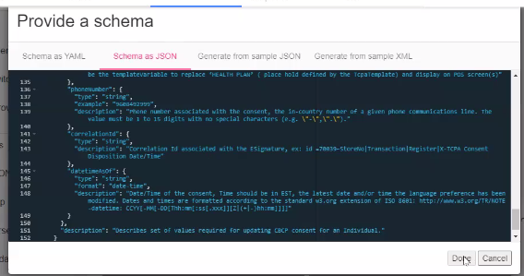
Mapping to Swagger Services
Configuring Backend Swagger service – Setup response payload
Select Schema as JSON tab and paste in the copied content
Click Done

Slide 34
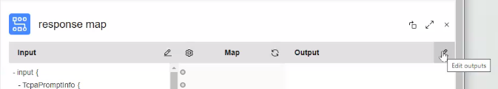
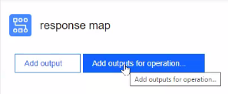
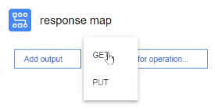
Mapping to Swagger Services
Configuring Backend Swagger service – Map response
Click the Edit outputs pencil on the output side
Click Add outputs for operation…
Click GET or the operation to be mapped

Slide 35
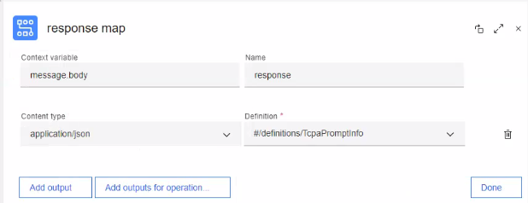
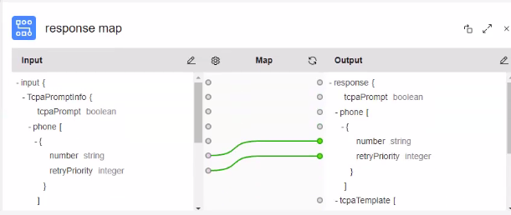
Mapping to Swagger Services
Configuring Backend Swagger service – Map response
The Response for the operation should be selected and displayed in the Definition
Select application/JSON for the Content type
Click Done
Map the Input to the Output
Click on the Source Attribute (dot) and connect to the target service attribute (dot) and click
Click Save

Slide 36
Mapping to XML Services
Introduction
This section describes how to create a Swagger API that maps to an XML service. The XML POST service is internally generated by an IA using RSA in the REST stream.
Some examples for using this process are:
To expose an XML POST based service through a REST API.
To expose a SOAP service as a REST API.
Reduce the payload for a mobile app.
Because XML POST services implemented in IIB always return http 200, special attention should be paid to error mapping.

Slide 37
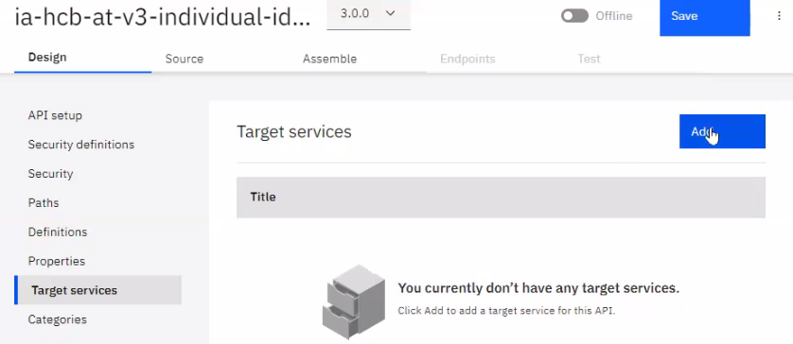
Mapping to XML Services
Swagger based API mapped to an XML based service
An API has already been created from YAML
Import a .zip IIB service that only includes .wsdl, and .xsd file structures that are pertinent to the API
Delete any .project,.emx, .xml, .sketch, .png…files that might be included in the .zip file.
Click Develop
Select Target services
Click Add

Slide 38
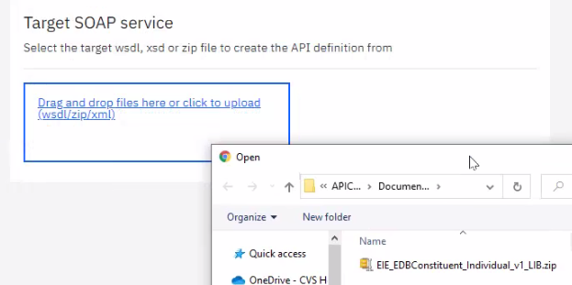
Mapping to XML Services
Swagger based API mapped to an XML based service
Select target .zip file from Explorer
Click Ok

Slide 39
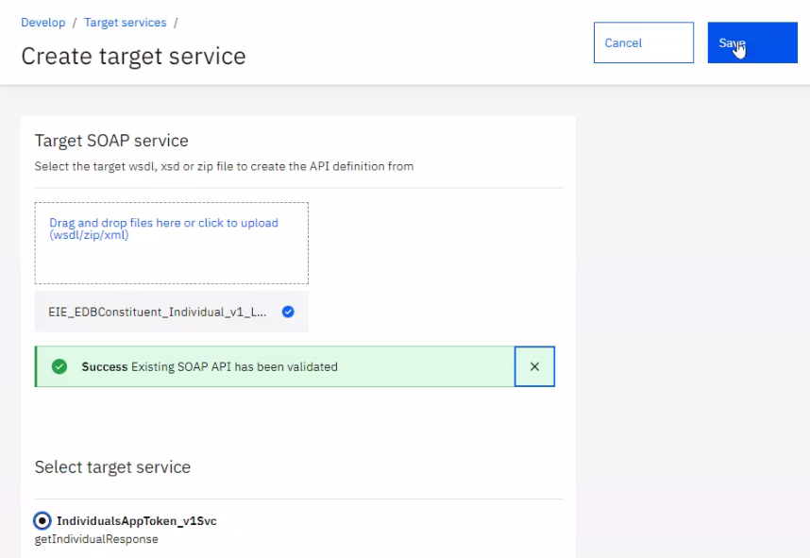
Mapping to XML Services
Target Service
Select the target Service
Click Save

Slide 40
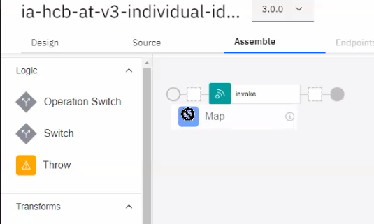
Mapping to XML Services
Assembly Map
Click Assemble
Drag map from Transforms area to the assembly and place before the Invoke (dotted lined box appears on line)

Slide 41
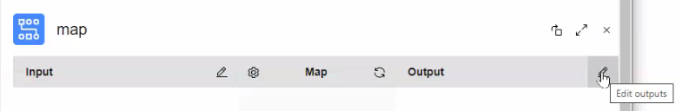
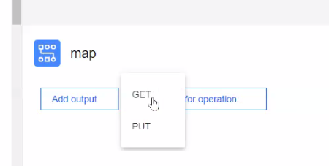
Mapping to XML Services
Output Operation
On the Output
Click Edit outputs pencil on the Output side
Click either Add output or Add outputs for operation (if multiples are available)
Select the operation

Slide 42
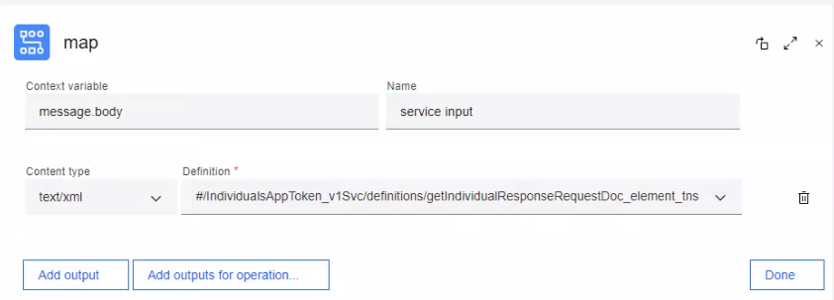
Mapping to XML Services
Output Definition
Enter service input for the Name
Select the desired definition
Click Done

Slide 43
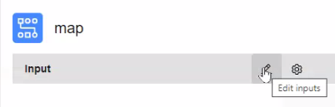
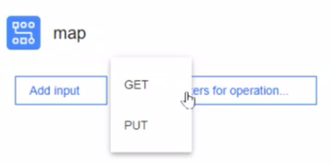
Mapping to XML Services
Input Operation
On the Input
Click Edit inputs (Pencil)
Click either Add inputs or Add inputs for operation (if multiples are available)
Select the operation

Slide 44
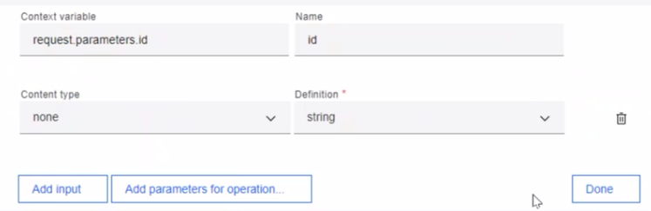
Mapping to XML Services
Input Definition
Click Done

Slide 45
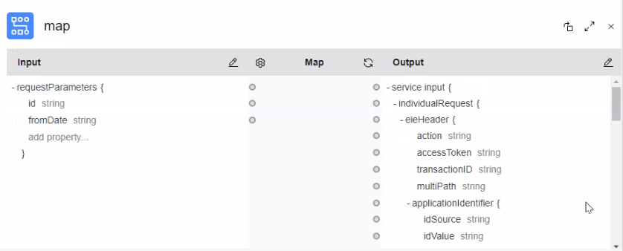
Mapping to XML Services
Input\Output Final result
Attributes are displayed

Slide 46


Mapping to XML Services
Input\Output Final result
Click on the Source Attribute (dot) and connect to the target service attribute (dot) and click
Continue until all input parameters are mapped

Slide 47

Mapping to XML Services
IdType
For Identifiers
Click on the target service idType attribute (dot)
Set the Default to the type of the identifier from the PIM identifier spread sheet (Identifier.idType column)

Slide 48

Mapping to XML Services
IdSource
For Identifiers
Click on the target service idSource attribute (dot)
Enter the value:
$(id).split(“~”)[0]

Slide 49

Mapping to XML Services
idValue
Click on the target service idValue attribute (dot)
Enter the value:
$(id).split(“~”)[1]

Slide 50

Mapping to XML Services
Map
Click Assemble
Drag map from Transforms area to the assembly and place after the Invoke (dotted lined box appears on line)

Slide 51


Mapping to XML Services
Input Operation
On the Input
Click Edit Inputs (Pencil)
Click Add Input

Slide 52

Mapping to XML Services
Input Definition
Enter the message.body and service output
Select application/xml
Select the desired definition
Click Done

Slide 53


Mapping to XML Services
Output Operation
On the Input
Click Edit Inputs (Pencil)
Click Add Input

Slide 54

Mapping to XML Services
Output Definition
Enter the message.body and output
Select application/xml
Select the desired definition (This should match the Response 200 from within the service)
Click Done

Slide 55

Mapping to XML Services
Input\Output Final result
Click on the Source Attribute (dot) and connect to the target service attribute (dot) and click
Continue until all input parameters are mapped

Slide 56
Move proxy API from V5 to V10
Introduction
This section describes how to move a proxy API from V5 to V10.

Slide 57


Move proxy API from V5 to V10
Download
Within V5 APIConnect open the API
Click on the ellipsis and select Download
The YAML file will be placed in the local computer download folder
Within V10 APIConnect click Add button then select API

Slide 58


Move proxy API from V5 to V10
Select OpenAPI 2.0
Make sure that OpenAPI 2.0 is selected
Under Import, select Existing OpenAPI
Click Next

Slide 59


Move proxy API from V5 to V10
Import
Drag and drop or click the screen to select the file to import
From Download folder select the file to import
Click Open

Slide 60

Move proxy API from V5 to V10
Activate API
File has been imported and successfully validated
Click Next
Leave the Activate API check box unselected
Click Next
Click Edit API on the Summary page
The API will open in edit mode
Look at the “Name” field on the Info tab
If there are any “_” (underscore) characters in the name field replace them with “-” (dash)

Slide 61



Move proxy API from V5 to V10
Potential Issue
Due to some incompatibilities between V5 and V10 an invoke error may display
If there is no error, click here
If the error is displayed, use these steps to correct
Click on Assemble
Drag a new Invoke onto the Assemble

Slide 62



Move proxy API from V5 to V10
Assemble
Copy the Title and Description from the Original V5 Invoke and paste into the appropriate areas within the V10 Invoke
Delete the V5 Invoke which has an error
Click Save

Slide 63




Move proxy API from V5 to V10
Properties
Edit the Invoke
Enter: $(target-url)
Set the HTTP Method to Keep
Set Cache Type to No Cache
Ensure Time to Live is blank
Ensure Stop on error is unchecked
Click Save

Slide 64
Moving a mapped API from V5 to V10
Manual Process
This section describes how to move a mapped API from V5 to V10.
The APIC development team has a utility that will convert V5 APIs to V10 APIs that will update the assembly components to enable the use of the V10 DataPower API Gateways rather than the DataPower Gateway(v5 compatible). Converted APIs end with –apigw.
IF the API you need to modify is most current in v5, then it will also have to be migrated (possibly again) and imported into your development org. Export that API from the v5 API Manager and email that file to Roy Klein, Stephen Waldern (backup). One of them will use the conversion utility and return a file to you that can be imported into v10 in your development organization.
Once you have imported this Converted API into v10 it is recommended that you remove the –apigw from the title and name from your modified next version so we can tell that the most current version was modified in v10.

Slide 65
Importing an OpenAPI 3.0 for proxy API
Introduction
This section describes how to import and configure an interface defined using OpenAPI 3.0
OpenAPI 3.0 specifications can be found here
A discussion on differences between Swagger 2.0 and Open API3.0 can be found here

Slide 66



Importing an OpenAPI 3.0 for proxy API
Import
From Develop
Click Add and select API
Click OpenAPI 3.0
Under Import, select Existing OpenAPI
Click Next

Slide 67


Importing an OpenAPI 3.0 for proxy API
Import
Drag and drop or click the screen to select the file to import
Find and select the vendor file to upload and click Open

Slide 68

Importing an OpenAPI 3.0 for proxy API
Import
File has been imported and successfully validated
Click Next

Slide 69


Importing an OpenAPI 3.0 for proxy API
Import
Leave the Activate API check box unselected
Click Next
After the Summary click Edit API

Slide 70


Importing an OpenAPI 3.0 for proxy API
Import
When the API Opens look at the “Name” field on the Info tab
If there are any “_” (underscore) characters in the name field replace them with “-” (dash)
Click on the Policies tab to see the Invoke
The Policies tab of an OpenAPI3.0 is functionally similar to the Assembly tab of an OpenAPI2.0 section
Click on the Invoke
Go to Assembly for Proxy\Invoke Section of this document to complete this proxy setup

Slide 71
Importing a SOAP proxy API
Introduction
This process describes how to import and configure a SOAP proxy API including:
Internal first-class services.
Vendor SOAP service defined with WSDL.

Slide 72


Importing a SOAP proxy API
Select API
From Develop
Click Add and select API
Click OpenAPI 2.0
Under Create, select From existing WSDL service (SOAP proxy)
Click Next

Slide 73

Importing a SOAP proxy API
Select the zip file
Drag and drop or click the screen to select the file to import
The .zip file must contain only WSDL and XSD file formats
Find and select the file to upload and click Open

Slide 74

Importing a SOAP proxy API
Successful?
File has been imported and successfully validated
Click Next

Slide 75

Importing a SOAP proxy API
Continue
Click Next

Slide 76

Importing a SOAP proxy API
Enter details
Ensure that Title, Version and Base path are correct
Look at the “Name” field on the Info tab
If there are any “_” (underscore) characters in the name field replace them with “-” (dash)
Enter a Description
Click Next

Slide 77

Importing a SOAP proxy API
Security settings
Ensure Client Id and CORS settings are correct and Active API is not selected
Click Next

Slide 78

Importing a SOAP proxy API
Edit API
Click Edit API

Slide 79

Importing a SOAP proxy API
Assemble
After the API opens Use the Assemble tab to validate the Proxy
Enter the EndPoint in the Description
Validate the following:
Select Keep for the HTTP Method
Select No Cache for the Cache Type
Ensure Time to Live is blank
Ensure Stop on Error is unchecked

Slide 80
Cloning a V10 API
Introduction
This process describes how to duplicate an API including:
Creating an Opportunistic API from an Enterprise API.
Duplicating the use of an Opportunistic API for another consumer.
Cloning a V10 API requires downloading and updating using an editor like Notepad++.

Slide 81

Cloning a V10 API
Cloning
From Develop
Select the API to Clone
Using the ellipsis select Download

Slide 82


Cloning a V10 API
Cloning
Use an editor like Notepad or Notepad++ to modify the yaml
Update the title, x-ibm-name
Save the file (rename from the downloaded name)

Slide 83

Cloning a V10 API
Cloning
Import the updated file using the section, Importing Swagger 2.0 as a proxy
The API will have the updated Title and Name from the edited file

Slide 84

Cloning a V10 API
Cloning
Update the Path if necessary
Add or Remove any parameters
Update the Assemble for Mapping a XML based API or Mapping a Swagger based API or Invoke Endpoint differences

Slide 85
Create a new V10 API version
Introduction
This section describes how to create a new version of an existing API.

Slide 86

Create a new V10 API version
New Version
From Develop
Select the API to revise
Using the Ellipse select Save as New Version

Slide 87


Create a new V10 API version
New Version
Enter the new version number
Click Submit
Open the new Version
Edit as necessary

Slide 88
Create a new OpenAPI 2.0 using APIC V10
Introduction
This section describes how to create an API that exposes a Swagger (OpenAPI 2.0) using the API Connect V10 user interface.

Slide 89



Create a new OpenAPI 2.0 using APIC V10
APIC User Interface
From Develop
Click Add
Select API
Select OpenAPI 2.0
Select New OpenAPI from the options
Click Next

Slide 90

Create a new OpenAPI 2.0 using APIC V10
APIC User Interface
Enter information pertaining to the API
Enter a Title based on the submitted and approved Naming Request from SharePoint
Make sure to include /IA at the beginning of the name
Look at the “Name” field on the Info tab
If there are any “_” (underscore) characters in the name field replace them with “-” (dash)

Slide 91

Create a new OpenAPI 2.0 using APIC V10
APIC User Interface
Enter the version
Enter a Base path
Enter a Description
Click Next

Slide 92


Create a new OpenAPI 2.0 using APIC V10
APIC User Interface
Unless there are specific instructions to unselect these, leave them selected
Click Next
If there are no errors
Click Edit API
Otherwise correct any errors to continue

Slide 93



Create a new OpenAPI 2.0 using APIC V10
APIC User Interface
When the API opens
Scroll down the API and enter the following information
Enter the Summary
Ensure HTTPS is selected
Enter the Host name

Slide 94



Create a new OpenAPI 2.0 using APIC V10
APIC User Interface
Select the Appropriate Consumes and Produces
Scroll down to Gateway type
Although it is the default make sure that DataPower API Gateway is selected
Click Save to save the API
Scroll up to the top of the API to continue updating the API

Slide 95



Create a new OpenAPI 2.0 using APIC V10
APIC User Interface
Click on Security Definitions
Click on clientID
Enter the appropriate security definition in the description:
Ex.
{ "BuildEIEHeader": "Header V3.1.2",
SecurityTemplate": "AppPrivApp“,
"Backend": "IIB",
"Error handling policy": “Transparent",
"Mutual Authentication Required": "Not Required"}
Link to APIC Security Definition Template
Click Save

Slide 96



Create a new OpenAPI 2.0 using APIC V10
APIC User Interface
Click on Paths
Click on “/” to open the Path section
Enter the appropriate Path name
Click on Add to add path parameters
Add appropriate path parameters
Make sure to add a description for each parameter to identify its purpose
Once completed adding parameters, Click Save

Slide 97


Create a new OpenAPI 2.0 using APIC V10
APIC User Interface
Click on Paths
Expand the Path by clicking on the path name
Scroll to Operations
Delete all unneeded operations
Click Save

Slide 98

Create a new OpenAPI 2.0 using APIC V10
APIC User Interface
Expand the Path by clicking on the path name
Select the Operation to modify
Enter the Summary for the Operation
Enter the Description for the Operation
Click Save

Slide 99


Create a new OpenAPI 2.0 using APIC V10
APIC User Interface
Expand the Path by clicking on the path name and select the operation
Add any additional Parameters by clicking Add
Enter parameter information
Click Save

Slide 100

Create a new OpenAPI 2.0 using APIC V10
APIC User Interface
Expand the Path by clicking on the path name and select the operation
Scroll down to the Response section
Add any Response Parameters by clicking Add
Enter parameter information
Reference the Swagger Design document for valid response codes, uses and descriptions
When a more complex response is required that is not a Swagger primitive, manually create a definition.
See the Create complex definition section
Click Save

Slide 101

Create a new OpenAPI 2.0 using APIC V10
APIC User Interface
Complete the API by:
Creating any definitions as needed (link)
Importing any target services and map for XML based services as needed (link)
Importing any target services and map for Swagger based services as needed (link)
Completing a Proxy as needed (link)

Slide 102

Create a complex definition using API Connect V10
Introduction
This section describes how to define a JSON object with multiple properties and hierarchical structure using the API Connect V10 User Interface for Swagger 2.0.
When dealing with nested structures it’s best to start from the inner most “bottom” structure and build up to the final schema.
This example will show a contact object creation:
Start by building the name and address schemas then create a reference to each from the Contact schema

Slide 103

Create a complex definition using API Connect V10
APIC User Interface
Building complex definitions will be simplified if a bottom-up approach is taken
Click on Definitions ⊕

Slide 104


Create a complex definition using API Connect V10
APIC User Interface
Enter a Definition Name
Enter a Description
Click Create
Open the Schema to add Properties

Slide 105

Create a complex definition using API Connect V10
APIC User Interface
In the Properties
Click Add for each property (Definition or Reference) to add
Enter property information, if complex structure reference the desired schema
Click Save

Slide 106

Create a complex definition using API Connect V10
APIC User Interface
The final result is a Contact Schema with References to Name schema and Address schema and a phone property.

Slide 107
Create a new OpenAPI 3.0 using APIC V10
Introduction
This section describes how to create an API that exposes a Swagger (OpenAPI 3.0) using the API Connect V10 user interface.

Slide 108

Create a new OpenAPI 3.0 using APIC V10
Create a new OpenAPI 3.0
From Develop
Click Add
Select API (from REST, GraphQL or SOAP)
Select OpenAPI 3.0
Select New OpenAPI from the options
Click Next

Slide 109

Create a new OpenAPI 3.0 using APIC V10
Enter Title
Enter information pertaining to the API
Enter a Title based on the submitted and approved Naming Request from SharePoint
Make sure to include /IA at the beginning of the name

Slide 110

Create a new OpenAPI 3.0 using APIC V10
API Major.Minor.Patch Version and Description
Enter the Version
Enter a Description
The Base Path will default depending on the Title
Click Next

Slide 111

Create a new OpenAPI 3.0 using APIC V10
Continue with API design
Unless there are specific instructions to unselect these, leave them selected
Click Next
If there are no errors
Click Edit API
Otherwise correct any errors to continue

Slide 112


Create a new OpenAPI 3.0 using APIC V10
Contact Information
When the API opens
Look at the “Name” field on the Info tab
If there are any “_” (underscore) characters in the name field replace them with “-” (dash)
Scroll down and enter the following information
Enter Contact Name and Contact Email

Slide 113

Create a new OpenAPI 3.0 using APIC V10
Server URL
Click on Servers
Enter the Server URL (This is the combination of the Host name and the Base Path)

Slide 114

Create a new OpenAPI 3.0 using APIC V10
External Documentation
Click on External Documentation
Enter the following
URL:
https://eaintegrationgovernance.github.io/APIC-Common-Error-Codes.github.io/
Description:
HTTPS Common Error Codes

Slide 115



Create a new OpenAPI 3.0 using APIC V10
Establish Path
Expand Paths and select the default path “/”
Click Update
Enter the Path for the Interface
Click Save

Slide 116


Create a new OpenAPI 3.0 using APIC V10
Path Input Parameters
Select the Path to modify
Add parameters by clicking on the ⊕
Enter the Parameter Name and Description
Select “path” in the Located In drop down
Select Required
Click Create
Note:
Add any parameters that can be used across all operations

Slide 117


Create a new OpenAPI 3.0 using APIC V10
Schema and Type
Scroll down in the Parameters to Schema and click on Create
Select a Type from the drop down
Click Create

Slide 118

Create a new OpenAPI 3.0 using APIC V10
Remove uneeded Operations
Expand Paths
Expand the Path by clicking on the path name
Expand Operations
Delete all unneeded operations
Click Save (Top of the page)

Slide 119

Create a new OpenAPI 3.0 using APIC V10
Operation documentation
Expand the Path by clicking on the path name
Select the Operation to modify
Enter the Summary for the Operation
Enter the Description for the Operation
Click Save (Top of the page)

Slide 120


Create a new OpenAPI 3.0 using APIC V10
Operation Input Parameters
Expand the Operation to modify
Add parameters by clicking on the ⊕
Enter the Parameter Name and Description
Select “query” or other as appropriate
Scroll down and select other parameter options as needed. Ex. “Required”
Click Create

Slide 121
Create a new OpenAPI 3.0 using APIC V10
Update Parameter Schema and Type
Scroll down in the Parameter to Schemas and click on Create
Select a Type from the drop down
Click Create

Slide 122
Create a new OpenAPI 3.0 using APIC V10
Operation Response Parameters
New In OpenAPI 3.
Operation Responses are now defined by media type, e.g., application/json. Within the Content section of each Response, define, or provide a reference to, JSON Schema that describes the Response.
200 response is default and will just need to be updated with the correct schema
Other response require the addition of the application\json content type and then the correct schema
Follow these steps for each Operation Response

Slide 123


Create a new OpenAPI 3.0 using APIC V10
Operation Response Parameters
Expand the Operation to modify
200 is added by default
Add additional responses by clicking on the ⊕
Enter the response Name and Description
Click Create
Add additional responses as needed (404, 500…)

Slide 124



Create a new OpenAPI 3.0 using APIC V10
Response Content
Open the Response to add content
200 Response already has application/json Content defined. Edit that Content to define the Schema.
For other Responses …
Scroll down to enter Content
Click Add
Select application/json
Click Create

Slide 125



Create a new OpenAPI 3.0 using APIC V10
Response Content Type
Open the response to add content
Scroll down to enter Content Type (application\json)
Click on the type (application\json) to enter Schema criteria
In the Schema Click View to update
In the Schema Click Create to add

Slide 126

Create a new OpenAPI 3.0 using APIC V10
Response Content Schema
The Title and the Description are optional.
Select “string” in the Type or other schemas created in section.
See the Create complex schema section
Return here for additional responses

Slide 127


Create a new OpenAPI 3.0 using APIC V10
Adding Security Schemes
Expand Components
Add new security by clicking on the ⊕
Name OAuth
Select oauth2 as the type
Verify that placeholder-apigw is recorded in the OAuth Provider.
Select Implicit within the Flows dropdown
Click Create

Slide 128



Create a new OpenAPI 3.0 using APIC V10
Adding Security Schemes (oAuth)
Return to the Operations
Expand the Operation
Add new Security Requirements by clicking on the ⊕
Select oAuth2
Select appropriate scope
Click Create
Click Save

Slide 129
Create a new OpenAPI 3.0 using APIC V10
Completing the API
Complete the API by:
Creating any definitions as needed (link)
Importing any target services and map for XML based services as needed (link)
Importing any target services and map for Swagger based services as needed (link)
Completing a Proxy as needed (link)

Slide 130
Create a complex schema using API Connect V10
Introduction
This section describes how to define a JSON object with multiple properties and hierarchical structure using the API Connect V10 User Interface for OpenAPI 3.0
When dealing with nested structures it’s best to start from the inner most “bottom” structure and build up to the final schema.
This example will show a contact object creation:
Start by building the name and address schemas then create a reference to each from the Contact schema
{
“Contact":
{
"name":
{
"given": Frank,
"family": Enstein
},
"phone": "800.555.1212",
"address":
{
"street": "Main St",
"city" : "Anytown"
}
}
}

Slide 131

Create a complex definition using API Connect V10
APIC User Interface
Expand Components
Create a new schema by clicking on the ⊕

Slide 132

Create a complex definition using API Connect V10
APIC User Interface
Enter a Schema Name
Select “object” as Type
Enter a Description
Click Create

Slide 133

Create a complex definition using API Connect V10
APIC User Interface
In the Properties
Click Add for each property to add

Slide 134


Create a complex definition using API Connect V10
APIC User Interface
Enter property information
Click Create
After Creating a property, scroll down to enter sample data

Slide 135


Create a complex definition using API Connect V10
APIC User Interface
Creating object from the bottom up will simplify the effort.
In this example…Phone is a Property (object) that must be created within the Schema to be selected as a property type
Click Save

Slide 136

Create a complex definition using API Connect V10
APIC User Interface
The final result is a Contact Schema with References to Name schema and Address schema and a phone property.

Slide 137
Create an API Product
Introduction
This section describes how to create API Products to which Applications subscribe.
Products provide access to APIs, their paths and operations.
Products also control service loads via Rate Limits.

Slide 138


Create an API Product
APIC Product
From Develop
Click Add and select Product
Select New Product
Click Next

Slide 139

Create an API Product
APIC Product
Enter Title, Version
Click Next

Slide 140

Create an API Product
APIC Product
Select APIs to be included within the product
Click Next

Slide 141

Create an API Product
APIC Product
Set the Default Plan to one per week
Click Next

Slide 142

Create an API Product
APIC Product
Set Visibility to Authenticated
Set Subscribability to Authenticated
Click Next

Slide 143

Create an API Product
APIC Product
Click Edit Product

Slide 144

Create an API Product
Setting Default Plan Hard Limit
Open the Plan
Select Plans on the left side of screen.
To the right of Default Plans, click on the ellipses (3 vertical dots).
Select Edit.
Scroll down to Rate limits.
Set the Default to 1 Call per 1 Week
Check Hard limit.
Click on Save at the top of the screen.

Slide 145

Create an API Product
APIC Product
Click on the ellipses,
Select Edit,
Scroll down to Plan APIs.
Select Customize the plan API list
Click the Edit button

Slide 146

Create an API Product
APIC Product
Select the API to add to the Plan
Click Save

Slide 147

Create an API Product
APIC Product
Select Override plan rate limits for individual operation
Click Add

Slide 148

Create an API Product
APIC Product
Select the API
Select the Operation
Select Rate Limits
Click Add

Slide 149

Create an API Product
APIC Product
Name the rate limit “rate-limit-1”
Set the Rate Limit for the API Operation
Check the Hard Limit … then Save
We should strive for setting the rate limits to a 2-year projected volume when possible. Use:
100% buffer for very low volume APIs (< 500/hr.),
75% buffer for low volume APIs (<5000/hr.)
25-40% buffer for remaining APIs
For more details see APIC Products, Plans and rate-limits Guidance.pptx
Repeat for each operation
When complete Click Save at the Top of the screen

Slide 150
Publish an API Product to the Portal
Introduction
This section describes how to publish an API Product to a Development Provider Organization Portal.

Slide 151

Publish an API Product to the Portal
APIC Product Publish
From Develop
Select the ellipses next to the product
From the list select Publish
Note: Staging from Development Provider Organizations is no longer necessary.

Slide 152

Publish an API Product to the Portal
APIC Product Publish
Select “Sandbox” from the list of Catalog options
Click Publish

Slide 153

Publish an API Product to the Portal
APIC Product Publish - Issue
If the development provider organizations (or test environments) are not set up completely this error will be displayed
In this case, return to the API included within the product to adjust
The API Name that needs adjustment is found here.
This may need to be repeated for multiple API’s in an existing product

Slide 154

Publish an API Product to the Portal
APIC Product Publish – Issue resolution
Open the problem API
Expand Security Schemas
Click OAuth2

Slide 155

Publish an API Product to the Portal
APIC Product Publish – Issue resolution
Edit the OAuth Provider, Select placeholder-apigw from the dropdown
Edit the Flow, Select Implicit
Place https://placeholder-apigw/oauth2/authorize into the Authorization URL
You might need to use: https://placeholder-apigw/v3/internal/auth/oauth2/authorize in some provider orgs
Scopes should be set to PII or Public based on the API content.
Click Save at Top of Page
Follow steps to Publish the Product

Slide 156

Publish an API Product to the Portal
APIC Product Publish – Issue resolution
If this error is displayed when publishing the Product\API
Replace
Authorization URL: https://placeholder-apigw/oauth2/authorize
With the value displayed
Republish

Slide 157

Publish an API Product to the Portal
APIC Product Publish – Issue resolution
If the Product will still not publish check this setting on the Gateway tab
Uncheck Enforced
Click Save at Top of Page
Follow steps to Publish the Product

Slide 158
Publish an API Product to the Portal
APIC Product Portal
The Product and API are now found in the Portal

Slide 159
Delete an API Product from the Portal
Introduction
This section describes how to delete an API Product from the Development Organization Provider Portal.

Slide 160

Delete an API Product from the Portal
APIC Product Deletion
From Manage
Select the Sandbox within the Development Provider Organization

Slide 161


Delete an API Product from the Portal
APIC Product Deletion
Select the ellipsis to the right of the product
Select Retire

Slide 162


Delete an API Product from the Portal
APIC Product Deletion
Select the ellipsis to the right of the product
Select Delete

Slide 163
Download Realization for an API
Introduction
This section describes how to download an OpenAPI realization (YAML) from V10.

Slide 164

Download Realization for an API
APIC Realization download
Select the ellipsis next to the API to download
Import the downloaded .YAML file into RSA realization folder within the appropriate API Domain

